Slide 1
Events and Entertainment Officer

Slide 2
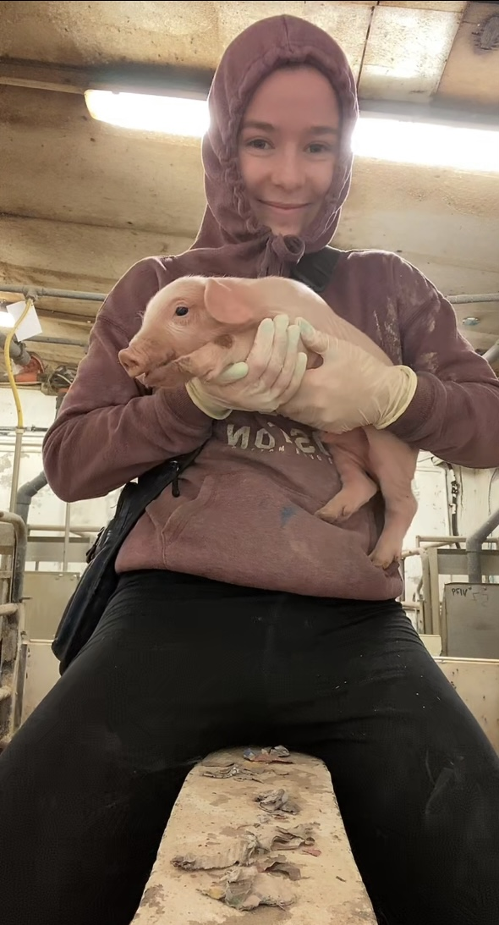
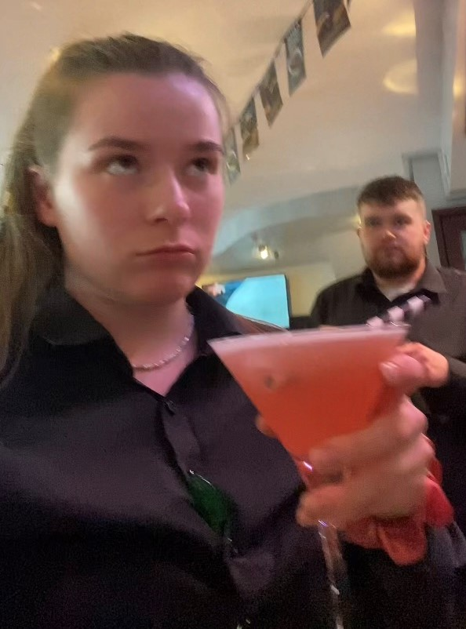
- I'm Martina, I'm 22 but I look a solid 17 <3 - I'm a 4th year Animal Science Student -So I've LOTS of time on my hands next year (Hopefully, cross your toes!) - I work 3 big boy jobs and go to college so I'm surprisingly good with time management :O - I've been in the trampoline club 4 years now (Still haven't landed 20 moves at Intermediate but anyways..)
About me !!!!

Slide 3
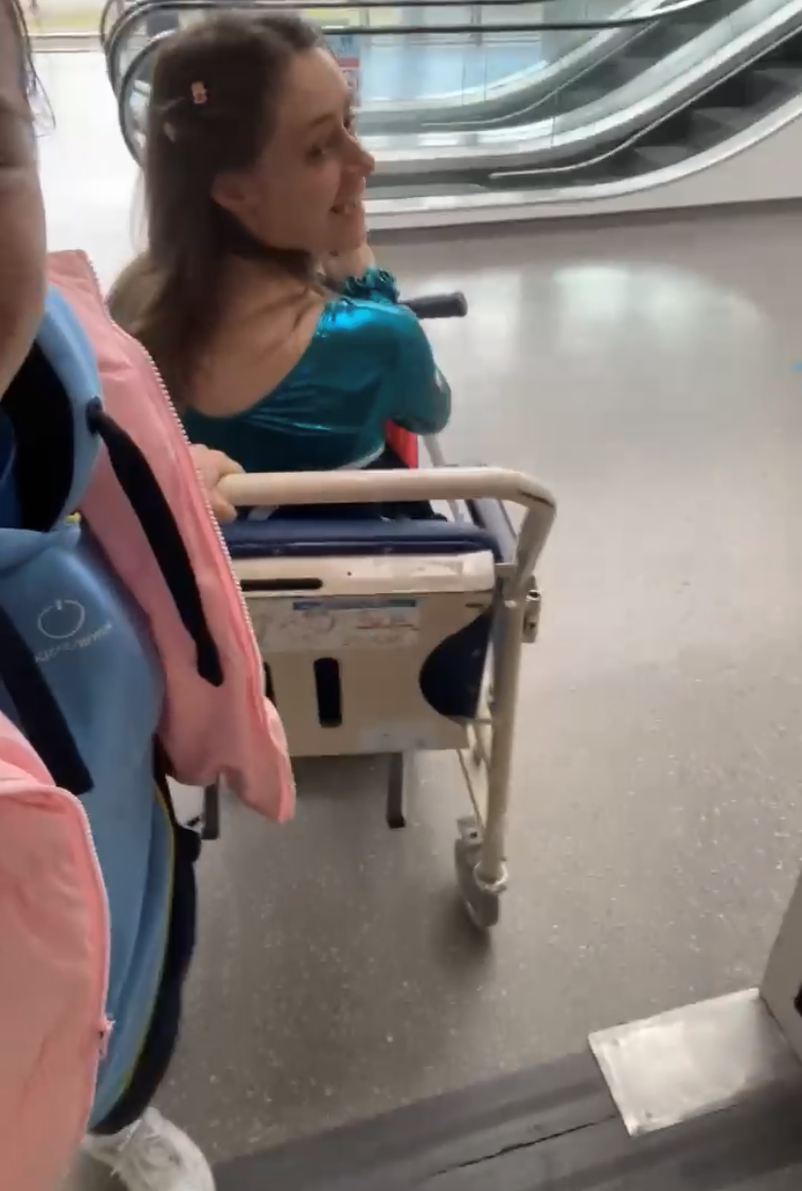
1) I love a cheeky night out! 2) I organise all of my work parties/ nights out so I have extensive experience in peer pressure ! 3) I look after all my sick and injured (and intoxicated) children 4) I'll even paint your gammy toes in A&E so the nurses don’t have to look at them. (See next slide) o.O
Why am I suited to this role ??????

Slide 4
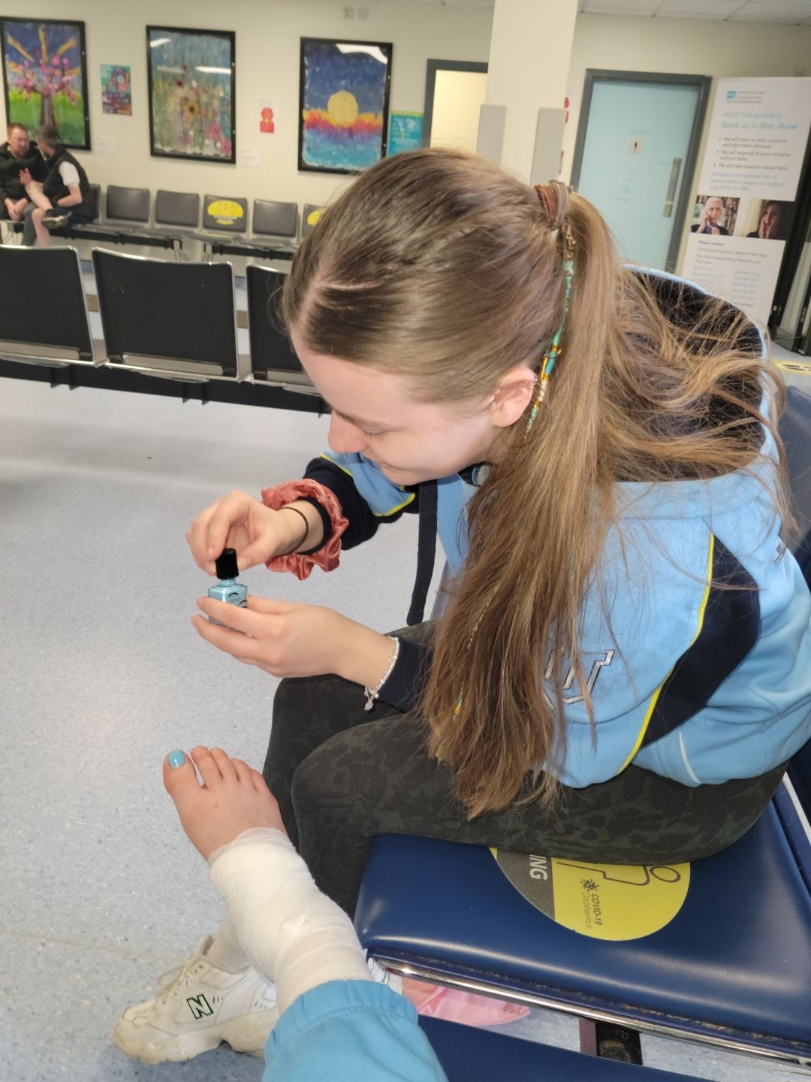

Slide 5
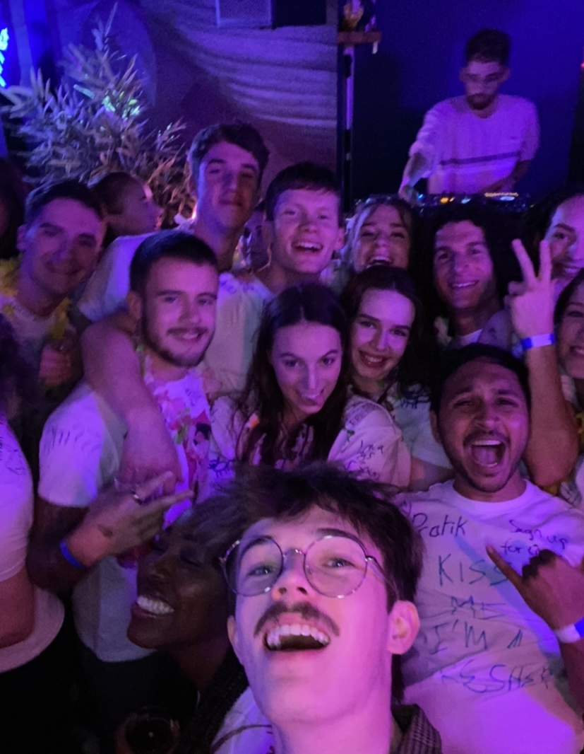
As we all know I love to talk and am always ready to make new people feel welcome and included.
I have lots of experience with public speaking from competitions and performing so there's no fear of me being shy!
I ABSOLUTLY love organised fun and am always down encourage group activities to get everyone involved.

Slide 6
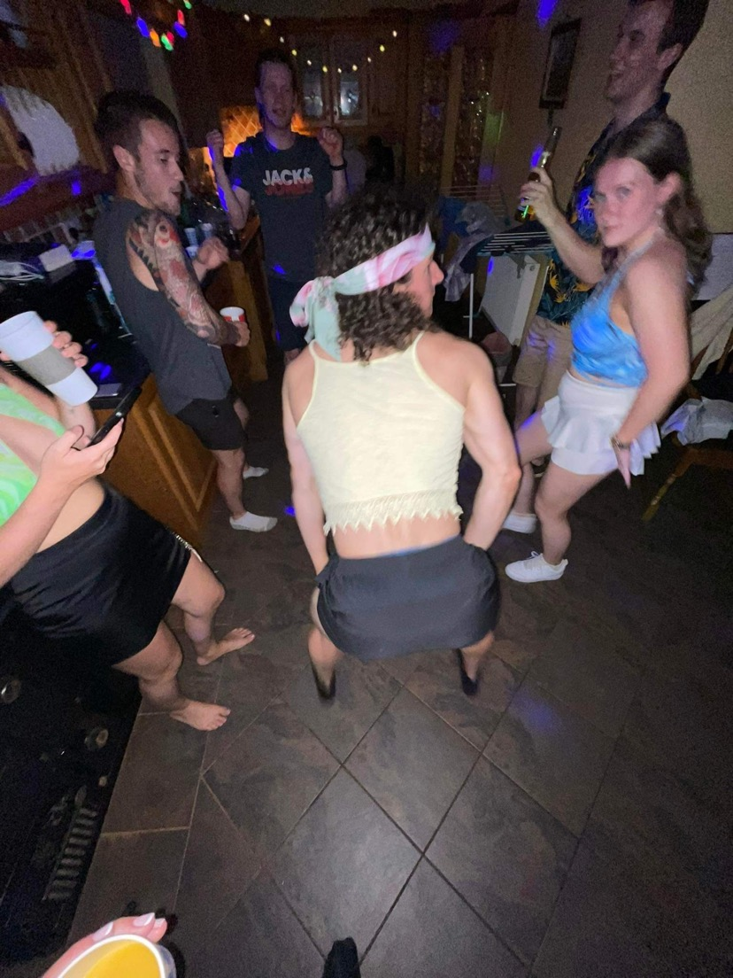
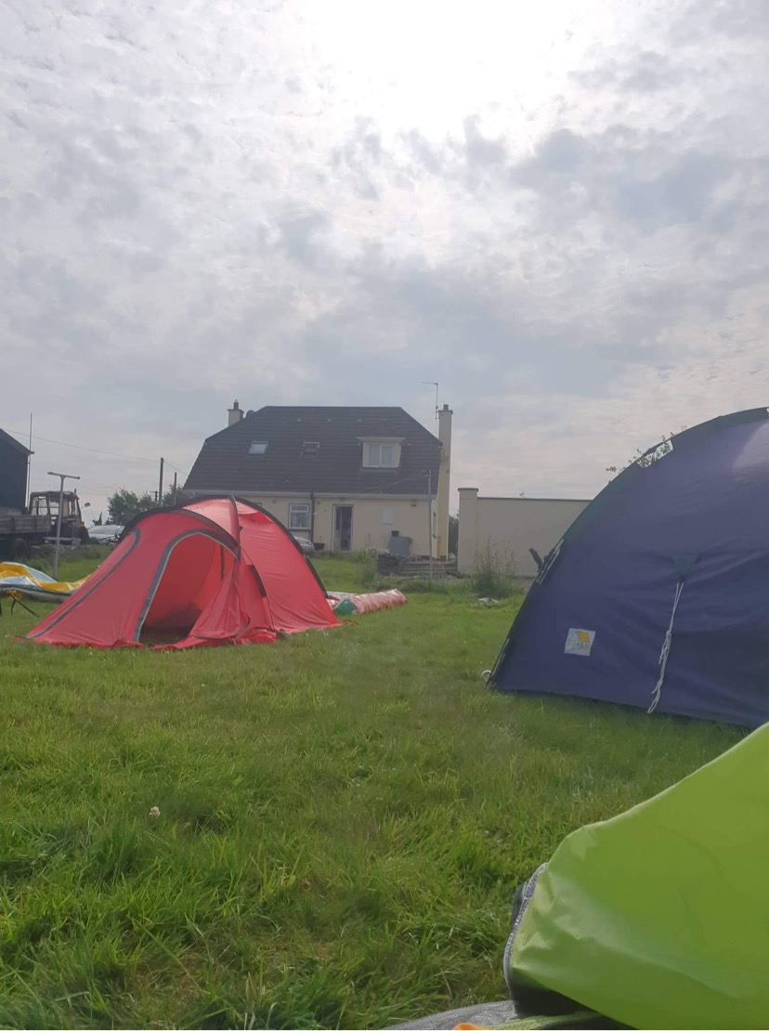
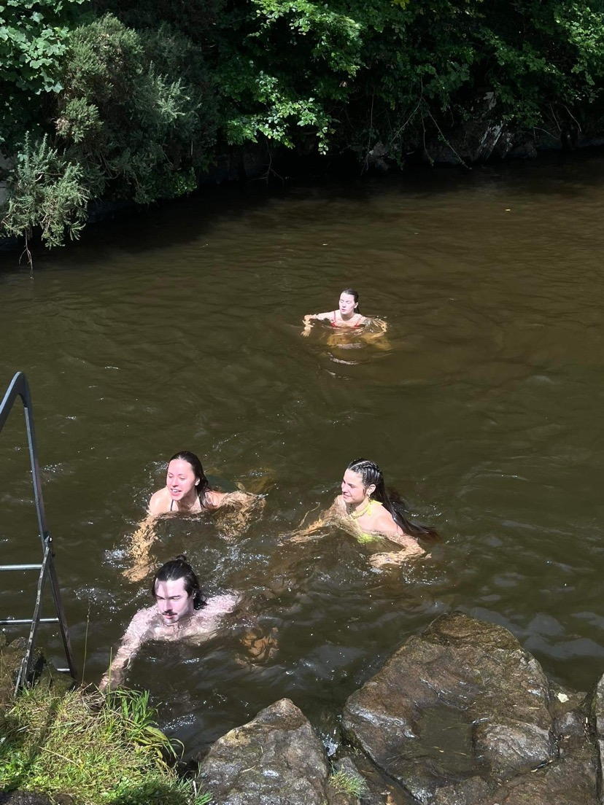
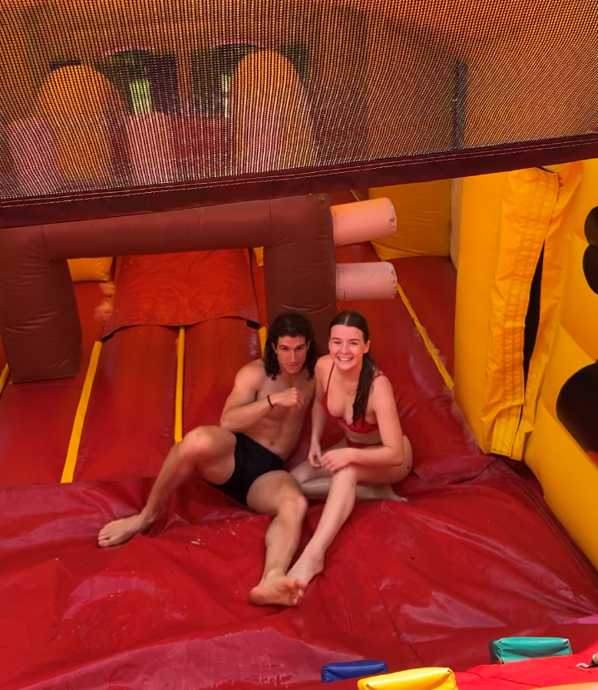
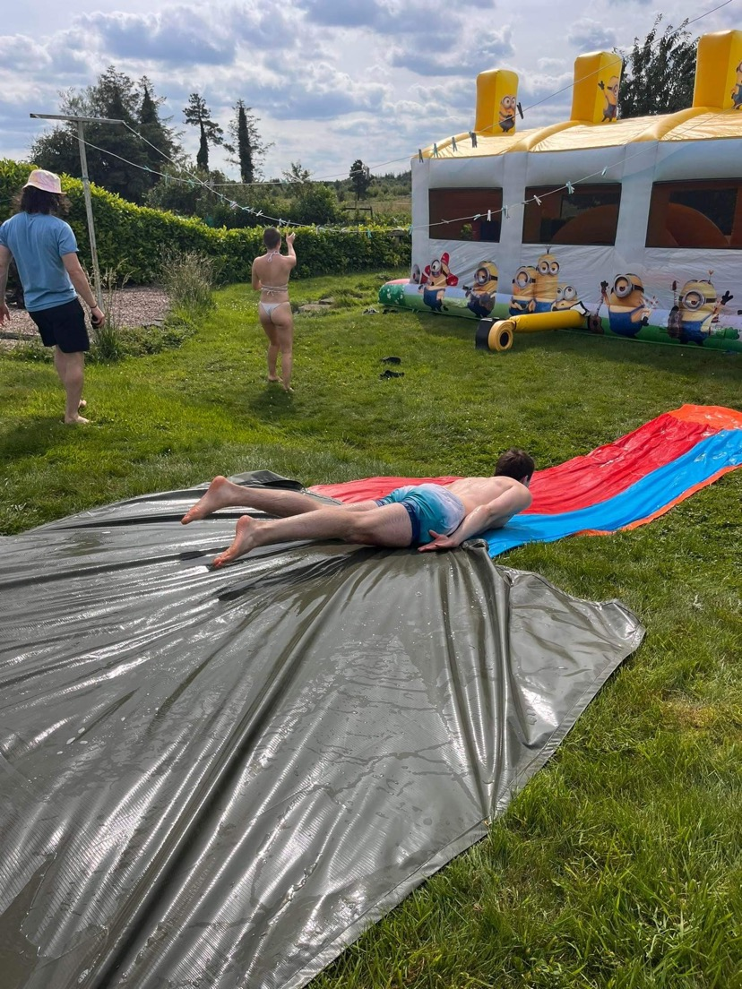
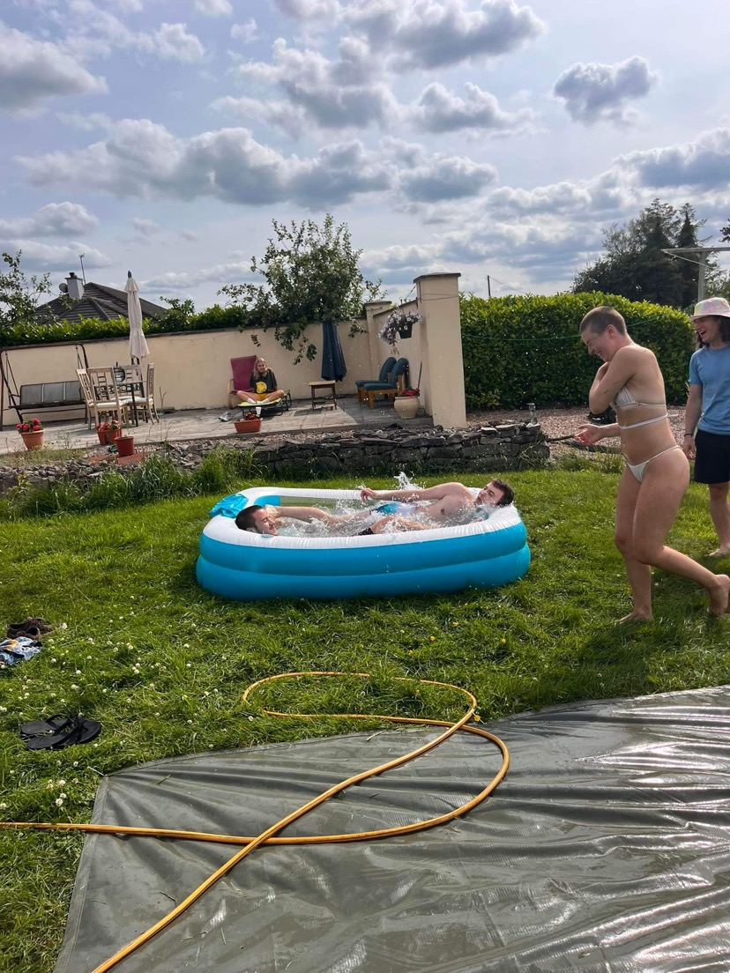
As we all know I love to host a good party or 10 so I'm aware of all the ins and outs that comes with managing
you lovely tramps ;)

Slide 7
JUST SOME CUTE EVENT IDEAS I'VE GOT:
Themed bouces ???
-Come dressed as your mammy/DA
-Nearly Naked Bounce (Yes I stole this from Chris. And ?)
Wholesome nights ? We've got them!
-Club dinners/lunches at least once a semester with a feedback box ( To facilitate everyone having their say, not just committee)
-Some day/ weekend trips:
Rock climbing, beach trips, maybe even camping? Who knows lets go crazy !!

Slide 8
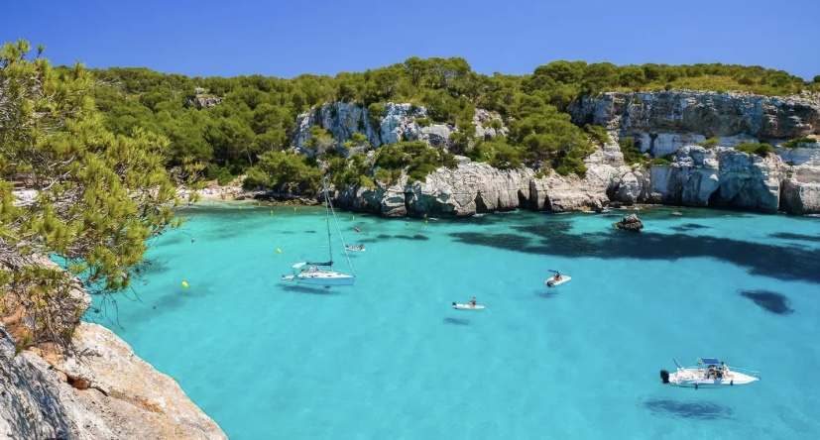
BIG BOY EVENTS
A ROAST NIGHT – Where we delve into the funny stories or things said by committee (or volunteers) and tell to our fellow tramps. And the winner will win a BIG PRIZE( Probably an out of date Easter egg, won't lie)
ABROAD TRAINING- Picture Cavan but now picture it where you near a beach, in the sun, surrounded by cheap alcohol and your long luscious locks in a warm breeze.

Slide 9
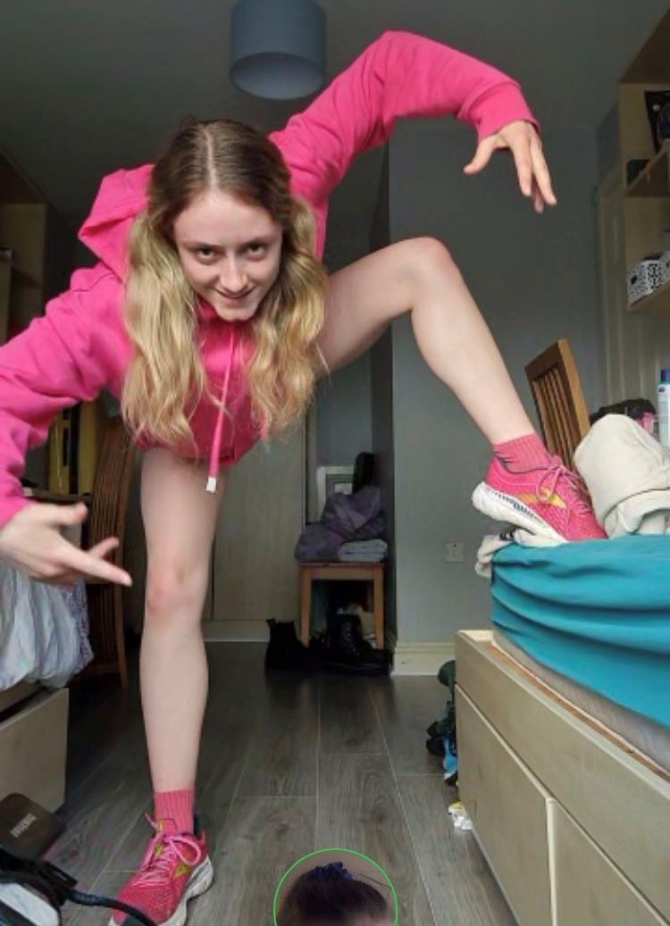
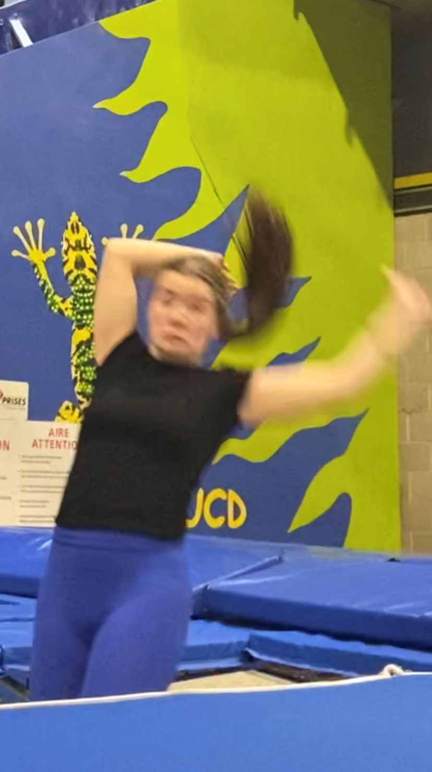
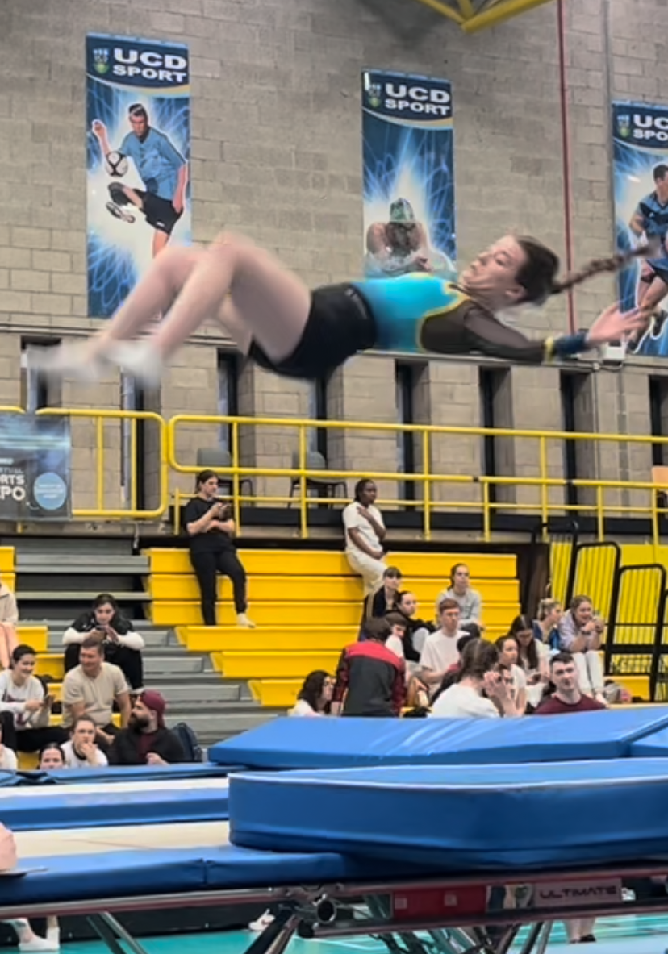
Lads I've too much to say, too little time. Best way to know if I'll be any good is to find out ;) I'll leave ye with these beauties <3

